Slide 1
EXAMINING THE RELATIONSHIP BETWEEN DECISION LEAD TIME AND THE PREDICTIVE PERFORMANCE OF PROACTIVE COMPLEX EVENT PROCESSING RULES DEVELOPED WITH WEATHER DATA DECISION TREES
Final Presentation
BRIAN GILSON
MAY 2019
Notes:
Committee
Dr. Fonda Na’Desh
Dr. Deborah Telfer
Dr. James Cox

Slide 2
OVERVIEW OF PRESENTATION
Present research on improving decision-support value of complex event processing (CEP) systems
Background topics
  Problem, purpose and significance, research question, theoretical framework, research methods
Data collection and analysis
  Population, sample, instrumentation, data description, data collection, data analysis
Meaning for stakeholders and researchers
  Findings, limitations, implications for practice, recommendations for research, conclusions
Notes:
CEP systems are common in Big data analyti

Slide 3
PROBLEM
The problem addressed in the study is the relationship between decision lead time and the predictive performance of proactive CEP rules developed with weather data decision trees has not been established (Christ, Krumeich, & KempaLiehr, 2016).
Predictive performance studied without specifying lead time
Predictive performance studied at an implied lead time of zero
The relationship between predictive performance and lead time not emphasized
Notes:
Real-World Problems when relationship is unknown:
Decision support potential of CEP systems is reduced
CEP systems limited to operate in reactive rather than proactive mode
Implemening CEP rules which match business decision-support objectives is difficult when relationship is unknown

Slide 4
PURPOSE
PURPOSE
The purpose of the study was to examine the relationship between decision lead time and the predictive performance of proactive CEP rules developed with weather data decision trees
GOAL
Evolve reactive CEP systems into proactive, event-driven systems with greater decision-support value to organizations
“The next phase in the evolution of CEP systems is proactive event-driven computing”
(Engel & Etzion, 2011)
Real-World Problem
  Decision support potential of CEP systems is reduced
  CEP systems limited to operate in reactive rather than proactive mode
  Implemening CEP rules which match business decision-support objectives is difficult when relationship is unknown

Slide 5
SIGNIFICANCE FOR STAKEHOLDERS
STAKEHOLDERS
  CEP system developers
  CEP rule developers and subject matter experts
  Business users and decision makers
  Domain specific societal beneficiaries
SIGNIFICANCE TO STAKEHOLDERS
  System developers may integrate better decision support features into CEP systems
  Rule developers may generate better rules without exclusive reliance on subject matter experts (SME’s)
  Users and decision makers can make better business decisions
  Proactive, domain-specific CEP systems serve society in many ways
Notes:
CEP Market potential (Mordor, 2018)
2.37 B IN 2017
0.79 B IN 2023

Slide 6
RESEARCH QUESTION
Research Question
RQ: To what extent, if any, is decision lead time related to the predictive performance of proactive CEP rules developed with weather data decision trees?
Hypotheses
H₀: There is no correlation between the decision lead time (IV) and the predictive performance of proactive CEP rules developed with weather data decision trees (DV).
H_{A}: There is a correlation between the decision lead time (IV) and the predictive performance of proactive CEP rules developed with weather data decision trees (DV).

Slide 7
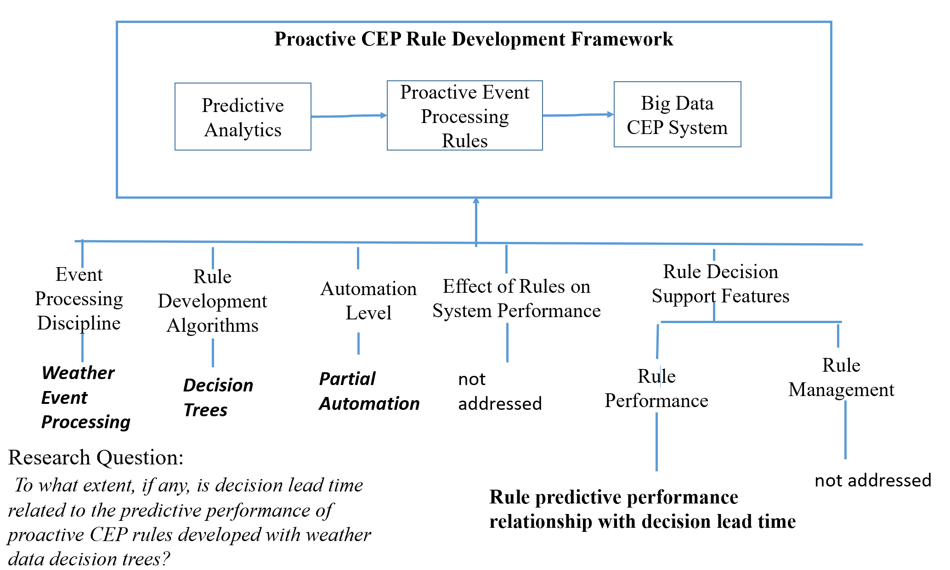
THEORETICAL FRAMEWORK

Slide 8
RESEARCH METHOD
QUANTITATIVE METHOD
  Quantitative methods identify a relationship between variables
  Mature discipline disciplines use quantitative methods (Edmondson & McManus, 2007)
  CEP is a mature discipline (Luckham, 2007)
CORRELATIONAL DESIGN
  More than descriptive analysis needed
  Correlation not cause and effect sought
  Not true experimental or quasi-experiment

Slide 9
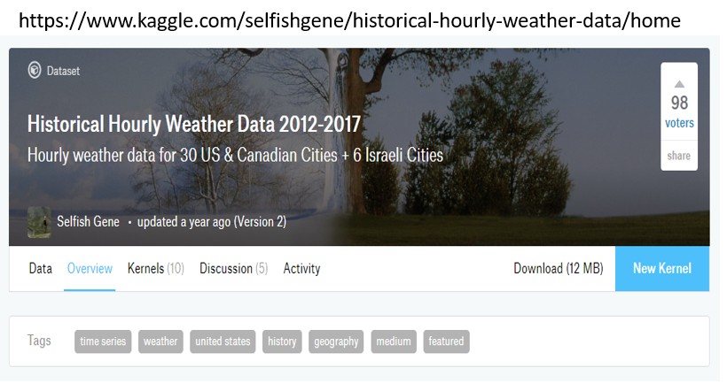
POPULATION
36 land-based weather stations in U.S., Canada, and Israel
Data from 2012 to 2017 conveniently accessible Kaggle
Open source data available on Open Weather Map API

Slide 10
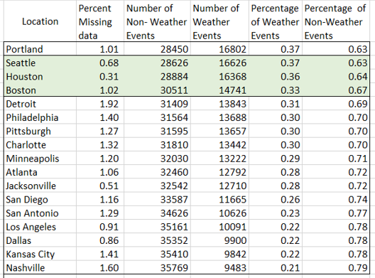
SAMPLE AND SAMPLING PROCEDURE
Three of 36 locations selected
Selection based on convenience sampling (Etikan, Musa, & Alkassim, 2016)
  Data quality
  Balance in the target variable
  Geographic dispersion
Sample selection process:
  Consolidate and link data for 36 stations in R
  Exploratory analysis of data quality and target variable balance
  Data selected based on low percentage missing and good balance in target variable
Seattle, Houston, and Boston selected

Slide 11
INSTRUMENTATION AND RELIABILITY
Instrument –
  Kaggle dataset
  based on Open Weather Map API
Reliability Meaning in quant study
  Reliability means consistent results in measurement (Salkind, 2010)
  Confidence in the results generated by the instruments (Huck, Cormier, & Bounds, 2012)
Reliability controls in study
  Used open source data
  Select high quality data
  Imputed missing results
  Made data and code publicly available
Notes:
Dependent variable IsWeatheEvent was a “construct” developed from weather event description field

Slide 12
VALIDITY
Internal validity
  Measures extent to which independent variables truly affect change in dependent variables
  Controlled overfitting by 70/30 random training to validation split
  Report performance results from validation dataset
External validity
  Measures extent to which results are applicable to larger population
  Inference to larger population not in scope of study
  Sampled three separate data stations based on low percentage missing predictors
Construct validity
  Control for IsWeatherEvent construct
    Exploratory analysis to assign weather event descriptions to binary IsWeatherEvent Category
    Principle of balance of fraction of weather events to non-weather events used in sample selection
  Control for predictive performance construct
    used 5 different commonly used metrics
    Sensitivity, specificity, accuracy, F-measure, and area under receiver operating characteristic (ROC) curve (AUC)

Slide 13
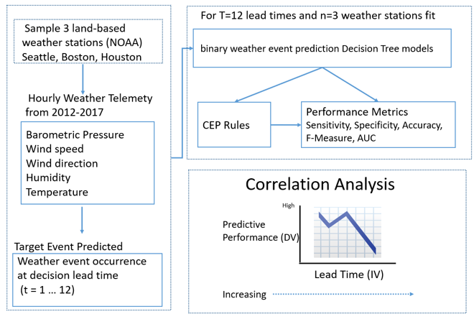
DATA COLLECTION AND ANALYSIS
Notes:
Data Collection
Download the raw data,
Identify the three locations to study,
Subset and link data for the three locations,
Impute missing data,
Format the dataset to create the lead time variables
Analysis
Separated the data into training and validation datasets.
Fit the decision tree models for all the lead times and locations.
Established and collected the model performance statistics for each lead time and location.
Conducted the hypothesis tests for significance of correlation and interpreted the results.
Prepared plots of the performance by lead time for each location and interpreted the plots.
Prepared plots of the decision trees and examined the variable retention patterns

Slide 14
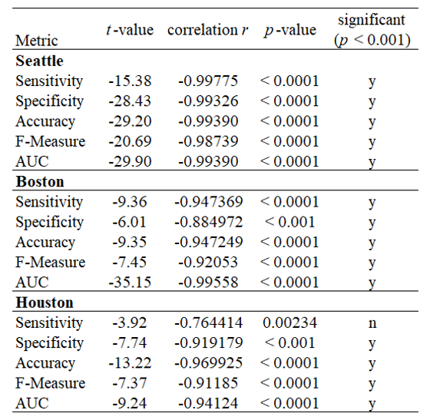
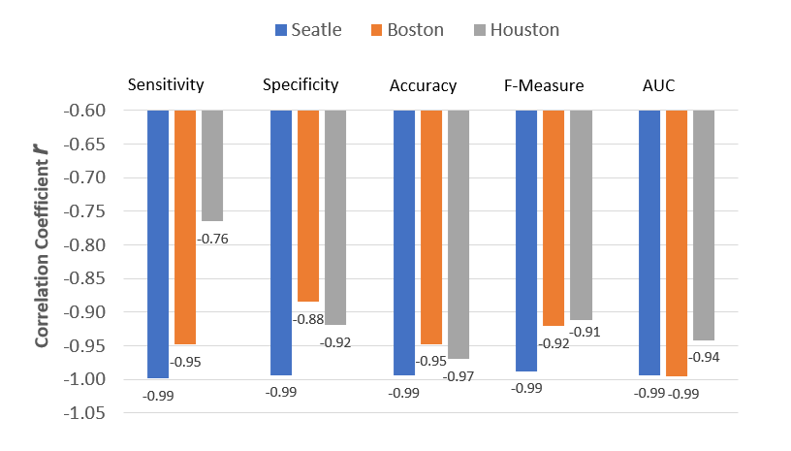
FINDING
Correlation Significance Summary by Location And Performance Metric
This study found that all performance metrics sensitivity, specificity, accuracy, F-Measure, and AUC had significant negative correlation with lead time for decision trees in locations Boston, Seattle, and Houston at the .001 level of significance except for the Houston sensitivity metric which was significant at the .01 level of significance.

Slide 15
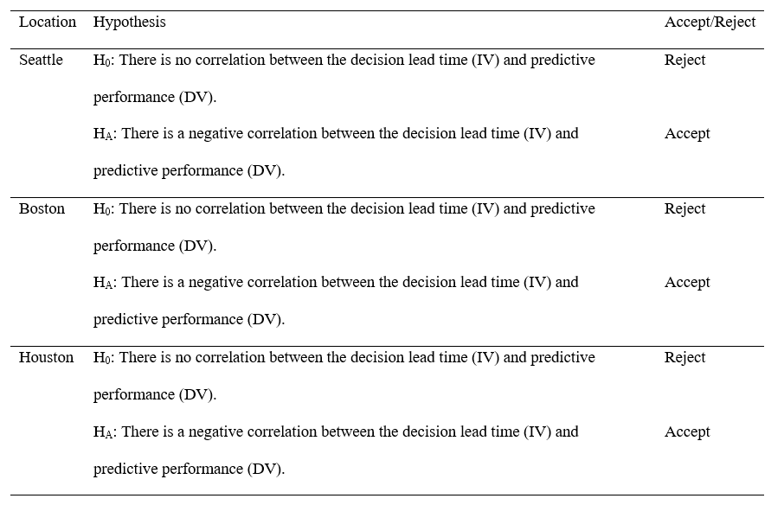
FINDING
Hypothesis Test Acceptance by Location
The null hypothesis of no correlation was rejected for all locations and the alternative hypothesis of negative correlation was accepted for each location Boston, Seattle, and Houston at the .001 level of significance.

Slide 16
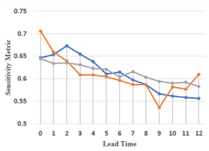
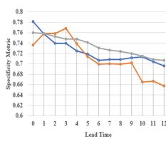
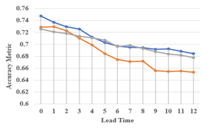
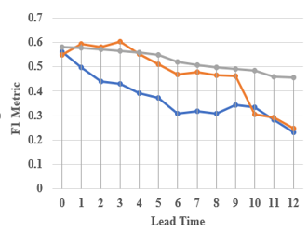
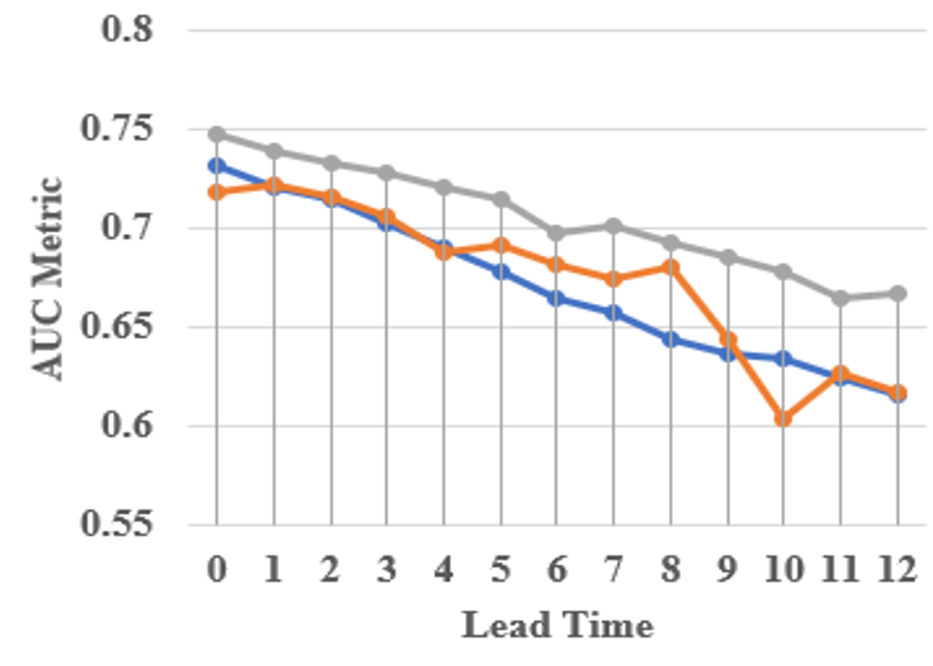
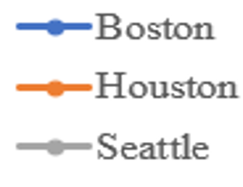
OBSERVATION
Variation in Strength of Linear Relationship
Linear relationship strongest for Seattle
More changepoints and deviations from linear patterns for Houston and Boston

Slide 17
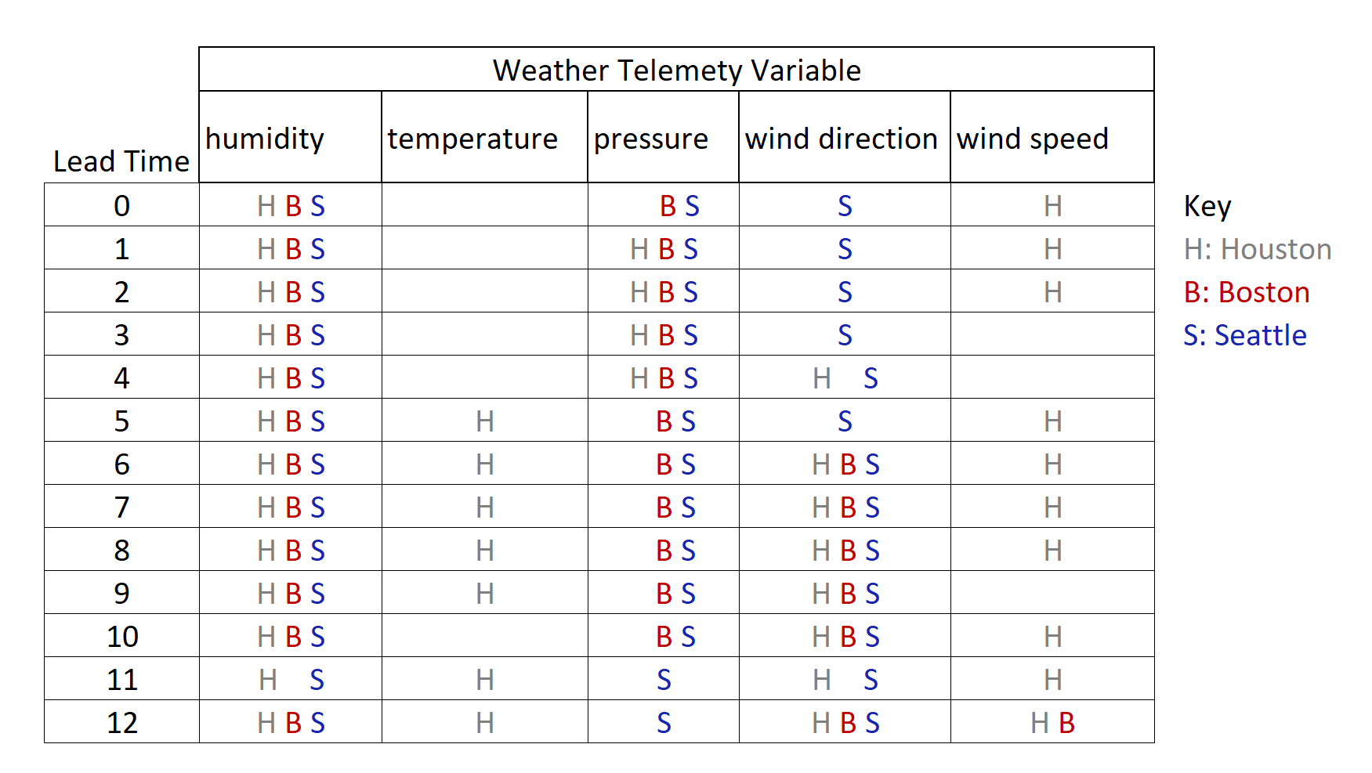
OBSERVATION
Decision Tree Variation Summary
Comparison of weather telemetry variables retained in trees
Notes:
The decision tree structures across the lead times and locations showed considerable variability regarding which telemetry variables the algorithm identified and retained in the trees.
Humidity occurred in trees across all lead times for each location.
Temperature occurred in the Houston trees after lead time 5.
Pressure occurred for all locations up to lead time 4 then only in Boston and Houston from lead times 5 to 10, then only Seattle for lead times 11 and 12. Wind direction occurred for Houston and Boston after lead time 6 but never for Seattle.
Wind speed occurred mostly in Houston except for except for lead times 3, 4, and 9.

Slide 18
FINDING ALIGNMENT WITH LITERATURE
Finding : Negative correlation between lead time and predictive performance
Agrees With Literature
Finding of negative correlation of accuracy with lead time consistent with many classic time series models (Hyndman & Athanasopoulos, 2018).
Hasan et al. (2016) also found decision tree classifier using weather telemetry variables was highly discriminative to predict weather events
Notes:
Hasan used C4.5 algorithm, I used rpart
The finding of significant negative correlation between lead time and predictive performance agrees with the concept that as a forecast interval increases, the ability to predict accurately decreases (Hyndman & Athanasopoulos, 2018).
Cugola et al. (2015) proposed a system CEP2U (Complex Event Processing under Uncertainty) which empased a conditional density and is related to accuracy

Slide 19
FINDING VARIES WITH LITERATURE
Finding : Negative correlation between lead time and predictive performance
Varies From Literature
Many studies emphasize accuracy or point density as a single performance metric (Cugola et al., 2015); this study viewed accuracy as one of five predictive performance metrics.
Non-linearities and changepoints by location vary with classic time-series models of Hyndman and Athanasopoulos (2018) which emphasize the relationship as monotonically decreasing.
Hasan et al. (2016) study achieved larger F-Scores (96.1%) than this study (60%)
Notes:
Hasan used C4.5 algorithm, I used rpart
The finding of significant negative correlation between lead time and predictive performance agrees with the concept that as a forecast interval increases, the ability to predict accurately decreases (Hyndman & Athanasopoulos, 2018).
Cugola et al. (2015) proposed a system CEP2U (Complex Event Processing under Uncertainty) which empased a conditional density and is related to accuracy

Slide 20
LIMITATIONS
Limited ability to Infer results to larger population due to small convenience sample of three areas
Limited ability to infer results to other event processing domains
Results sensitive to operational definition of IsWeatherEvent target variable
Simplistic feature selection due to inherent granularity of the data
Notes:
Make sure no additions

Slide 21
IMPLICATIONS AND RECOMMENDATIONS FOR PRACTICE
Leverage significant negative linear correlation when designing and using CEP systems for proactive decision support.
Account for non-linearities and changepoints when designing and using CEP systems for proactive decision support
Account for the possibility of changing decision-tree structures when designing and using CEP systems for proactive decision support

Slide 22
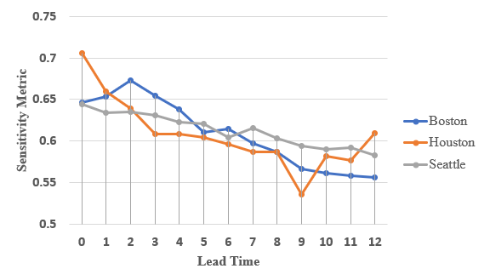
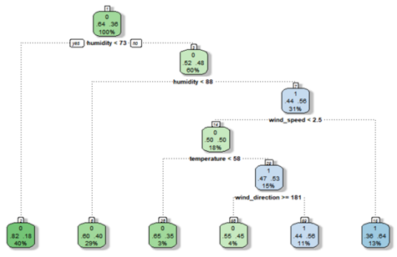
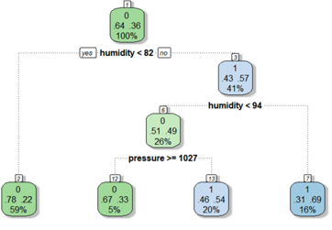
RECOMMENDATIONS EXAMPLE
Houston decision support policy emphasizes
  minimizing false negatives
  optimizing lead time and sensitivity metric
  at least 3 hours lead time needed
Sensitivity (recall, true positive rate) = TP/(TP + FN)
Recommendation: use decision-tree corresponding to lead time of 6
Sensitivity Metric by Lead Time
Lead Time 6
Lead Time 3
Notes:
Type I Error : reject a true null hypothesis, aka false positive FP, in the case of weather is predicting it is going to rain when it didn’t rain. You took your umbrella when it wasn’t needed.
Specificity (true negative rate) = TN/(TN + FP)
Type II Error : accept a false null hypothesis, or false negative FN, in the case of weather it is not predicting it is going to rain when it actually rains. You didn’t take the umbrella, and got soaked.
Sensitivity (recall, true positive rate) = TP/(TP + FN)
In Houston care about the Type II Error and thus care about sensitivity
Not much difference in sensitivity metric between 3 and 6 lead time
If additional lead time is desired, then use the decision tree for lead time 6
Decision tree for lead time 6 rules are moe complicated

Slide 23
IMPLICATIONS FOR THE FIELD
The finding and observations from this study illuminate the nature of the relationship between decision lead time and predictive performance for proactive CEP systems
This study also shows a straight-forward, practical way to structure an empirical research study to discover this relationship
The results of this study can influence the research community to give greater emphasis on defining and refining CEP systems to provide better decision-support functionality for stakeholders

Slide 24
RECOMMENDATIONS FOR FUTURE RESEARCH
Study effect of operational definition of IsWeatherEvent on results.
Improve the ability to infer to a larger population by replicating the study on additional locations (external validity).
Study effect of analysis granularity in concert with other variables in an experimental or quasi-experiment.
Notes:
Perhaps a different or refined definition can explain some of the non-linearities and changepoints

Slide 25
CONCLUSIONS
Purpose:
The purpose of the study was to examine the relationship between decision lead time and the predictive performance of proactive CEP rules developed with weather data decision trees -- with the goal of using the relationship to help evolve reactive CEP systems into proactive, event-driven systems with greater decision-support value to organizations
As conclusions offered, stakeholders may:
  Use decision trees to establish CEP rules with known predictive performance at a lead time to predict weather events.
  Leverage study result of negative correlation between decision lead time and predictive performance to match CEP rules with proactive decision-support policies.
  Leverage non-linearities and changing decision tree structures to match CEP rules with proactive decision-support policies.
Notes:
No new information
Validated use of decsison trees and the R rpart algorithms in particular

Slide 26
CLOSURE
Efforts to integrate predictions into CEP systems can be valuable
Can be a differentiator to successfully “Compete on Analytics” (Davenport, 2007)
Thanks to all who supported in this effort
Notes:
Goal was to ….
Achieved this ….
Could be new information , final take away
Thank you I’m done

Slide 27
REFERENCES
Christ, M., Krumeich, J., & Kempaliehr, A. W. (2016). Integrating predictive analytics into complex event processing by using conditional density estimations. Paper presented at the 2016 IEEE 20th international enterprise distributed object computing workshop (EDOCW).
Cugola, G., Margara, A., Matteucci, M., & Tamburrelli, G. (2015). Introducing uncertainty in complex event processing: model, implementation, and validation. Computing, 97(2), 103-144.
Davenport, T. (2007). Competing on analytics (Vol. 41, pp. 52-55): Computerworld.
Edmondson, A. C., & Mcmanus, S. E. (2007). Methodological fit in management field research. Academy of management review, 32(4), 1155-1179. Doi:10.5465/amr.2007.26586086
Etikan, I., Musa, S. A., & Alkassim, R. S. (2016). Comparison of convenience sampling and purposive sampling. American Journal of Theoretical and Applied Statistics, 5(1), 1-4.
Hasan, N., Uddin, M. T., & Chowdhury, N. K. (2016). Automated weather event analysis with machine learning. Paper presented at the 2016 international conference on innovations in science, engineering and technology (ICISET).

Slide 28
REFERENCES
Hyndman, R. J., & Athanasopoulos, G. (2018). Forecasting: principles and practice: otexts.
Luckham, D. (2007). A short history of complex event processing part 1. Retrieved from http://complexevents.Com/wp-content/uploads/2008/
Mehdiyev, N., Krumeich, J., Enke, D., Werth, D., & Loos, P. (2015). Determination of rule patterns in complex event processing using machine learning techniques. Procedia computer science, 61, 395-401. Doi:http://dx.Doi.Org/10.1016/j.Procs.2015.09.168
Mordor (2018). Global complex event processing (CEP) market. Mordor intelligence. Retrieved from https://www.Mordorintelligence.Com/industry-reports/global-complex-event-processing-cep-market-industry
Sokolova, M., & Lapalme, G. (2009). A systematic analysis of performance measures for classification tasks. Information Processing & Management, 45(4), 427-437. doi:https://doi.org/10.1016/j.ipm.2009.03.002

Slide 29
EXAMINING THE RELATIONSHIP BETWEEN DECISION LEAD TIME AND THE PREDICTIVE PERFORMANCE OF PROACTIVE COMPLX EVENT PROCESSING RULES DEVELOPED WITH WEATHER DATA DECISION TREES
Final Presentation
BRIAN GILSON

Slide 30
BACKUP

Slide 31
CONSTRUCT VALIDITY
Predictive Performance
The concept of predictive performance has many concepts, definitions, and associated metrics (Sokolova & Lapalme, 2009)
Performance metrics are based on functions of true positives (TP), true negatives (TN), false positives (FP) and false negatives (FN)
Predictive performance construct used five common metrics: Sensitivity, specificity, accuracy, F-measure, and area under receiver operating characteristic (ROC) curve (AUC)
Emphasis for selecting metrics based on minimizing two main classification errors
  Type I Error = False positive rate
  Type II Error = False negative rate
Specificity (true negative rate) = TN/(TN + FP) is high when FP is low
Sensitivity (recall, true positive rate) = TP/(TP + FN) is high when FN is low
Notes:
Sensitivity: measures true positive rate
Specificity (recall) : measures true negative rate
Accuracy: overall effectiveness
Precision: measures class agreement for positive labels
F-measure: harmonic mean of precision and sensitivity
AUC – overall ability to avoid false classification
Type I Error : reject a true null hypothesis, aka false positive FP, in the case of weather is predicting it is going to rain when it didn’t rain. You took your umbrella when it wasn’t needed.
Specificity (true negative rate) = TN/(TN + FP)
Type II Error : accept a false null hypothesis, or false negative FN, in the case of weather it is not predicting it is going to rain when it actually rains. You didn’t take the umbrella, and got soaked.
Sensitivity (recall, true positive rate) = TP/(TP + FN)
Dependent variable IsWeatheEvent was a “construct” developed from weather event description field

Slide 32
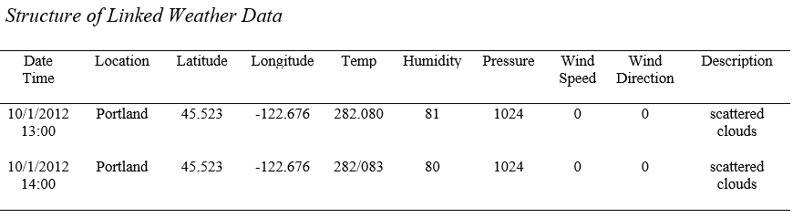
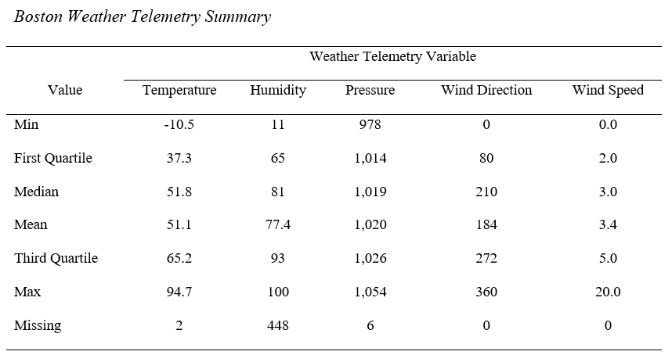
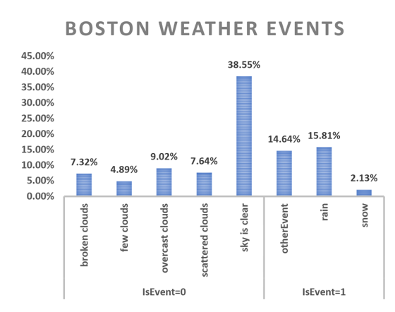
DATA DESCRIPTION
hourly granularity
Binary dependent variable:
IsWeatherEvent = 1 yes
IsWeatherEvent = 0 no
Five independent variables:
temperature, humidity pressure, wind direction and wind speed

